Slide 1


Multi-Class Animal Classification
Name - Mrunmay Shashikant Deshpande
AICTE StudID - STU679074d6762ac1737520342

Slide 2

Learning Objectives
1.Understand the fundamentals of image classification using deep learning.
2.Preprocess and augment image data for training machine learning models.
3.Build and train a CNN model for multi-class animal classification.
4.Evaluate the performance of a classification model using accuracy and loss metrics.
5.Optimize model performance through tuning techniques.
6.Deploy and test the model on new images.
GOAL
Source :
www.freepik.com/

Slide 3
Tools and Technology used
1. Libraries & Frameworks
TensorFlow / Keras – For building, training, and evaluating the deep learning model.
NumPy – For numerical operations and array manipulations.
Matplotlib – For visualizing training results (accuracy/loss graphs).
Seaborn – For enhanced data visualization (e.g., confusion matrix).
Scikit-learn – For computing classification metrics like the confusion matrix.
2.Development Environment
Jupyter Notebook – Interactive development and visualization.
Google Colab – For cloud-based execution using GPU acceleration.
3.Machine Learning Techniques
Convolutional Neural Network (CNN) – Deep learning model used for classifying animal images.
Data Augmentation – Techniques to increase dataset diversity and improve model robustness.
Model Evaluation Techniques – Accuracy, loss curves, and confusion matrix for performance assessment.

Slide 4
Methodology
1.Data Collection: Animal image dataset organized by class folders.
2.Preprocessing: Images resized, normalized, and augmented using ImageDataGenerator.
3.Model Building: A CNN is designed using Keras with convolutional, pooling, dropout, and dense layers.
4.Compilation: Model compiled with categorical_crossentropy, adam optimizer, and accuracy metric.
5.Training: Model trained on the dataset with validation, tracking accuracy and loss.
6.Evaluation: Performance evaluated using plots and a confusion matrix.
7.Testing: Model tested on new images for class prediction.

Slide 5
Problem Statement:
In many real-world scenarios, accurately identifying and classifying animals from images is crucial—for example, in wildlife monitoring, biodiversity studies, and automated animal surveillance systems. Manual classification is time-consuming, prone to human error, and not scalable for large datasets.
This project aims to develop an intelligent deep learning model that can automatically classify animal images into multiple categories (e.g., cats, dogs, elephants, etc.) using a Convolutional Neural Network (CNN). The solution should be capable of handling different image conditions and provide high accuracy and generalization for unseen data.

Slide 6
Solution:
1.Image Preprocessing & Augmentation
All images are resized and normalized.
Data augmentation techniques are applied to improve model robustness and prevent overfitting.
2.Model Development
A deep learning model (CNN) is built using multiple convolutional, pooling, and dropout layers.
The final layer uses softmax activation for multi-class classification.
3.Model Training
The model is trained on labeled animal images using the augmented training set.
Validation is performed to monitor performance during training.
4.Model Evaluation
Accuracy and loss metrics are analyzed using visual plots.
A confusion matrix is generated to assess class-wise performance.
5.Prediction on New Images
The trained model is used to classify new, unseen animal images with high accuracy.

Slide 7
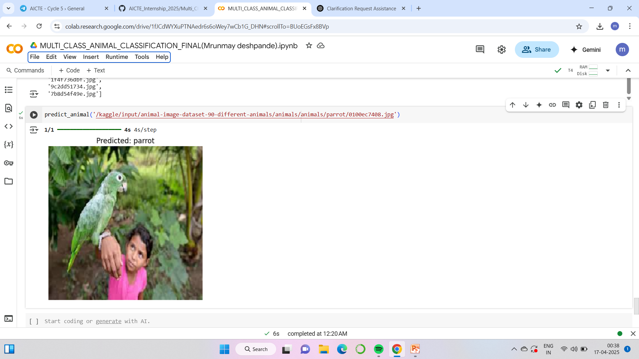
Screenshot of Output:

Slide 8
Conclusion:
The multi-class animal classification project successfully demonstrated the ability to categorize various animal species based on their characteristics and features. By leveraging machine learning techniques, specifically [e.g., Convolutional Neural Networks (CNN)], we were able to achieve a reliable classification model.
Throughout the project, we addressed key challenges, and took steps to mitigate these issues. The model's performance was further enhanced by careful preprocessing and feature extraction, ensuring that the input data was in an optimal format for the classifier.
The success of this project suggests that multi-class classification models can be effectively applied to real-world problems, such as animal identification for conservation efforts, biodiversity studies, and educational tools. Future work can focus on improving the model's generalization to unseen data by experimenting with different architectures, increasing the dataset size, or incorporating transfer learning techniques.

